Slide 1
Automatic pronunciation detector
A.Sandhiya
DEPT OF CSE-Final year
PODHIGAI COLLEGE OF
ENGINEERING AND TECHNOLOGY

Slide 2
Introduction
→The Pronunciation Detector is a web-based app.
→Helps users practice and improve English pronunciation.
→ Includes listening and speaking exercises.
→Designed with learning levels (Beginner to Advanced).

Slide 3
OBJECTIVES:
→Improve spoken English with interactive practice
→Test pronunciation through voice recognition
→Provide multiple domains (AI, Cyber Security, etc.)
→Offer self-paced levels: Practice and Challenge

Slide 4
TECHNOLOGY USED
→Frontend : HTML , CSS , JavaScript
→Backend : Python(Flask Framework)
→Database : MongoDB
→Speech Processing : SpeechRecognition and ptttsx3

Slide 5
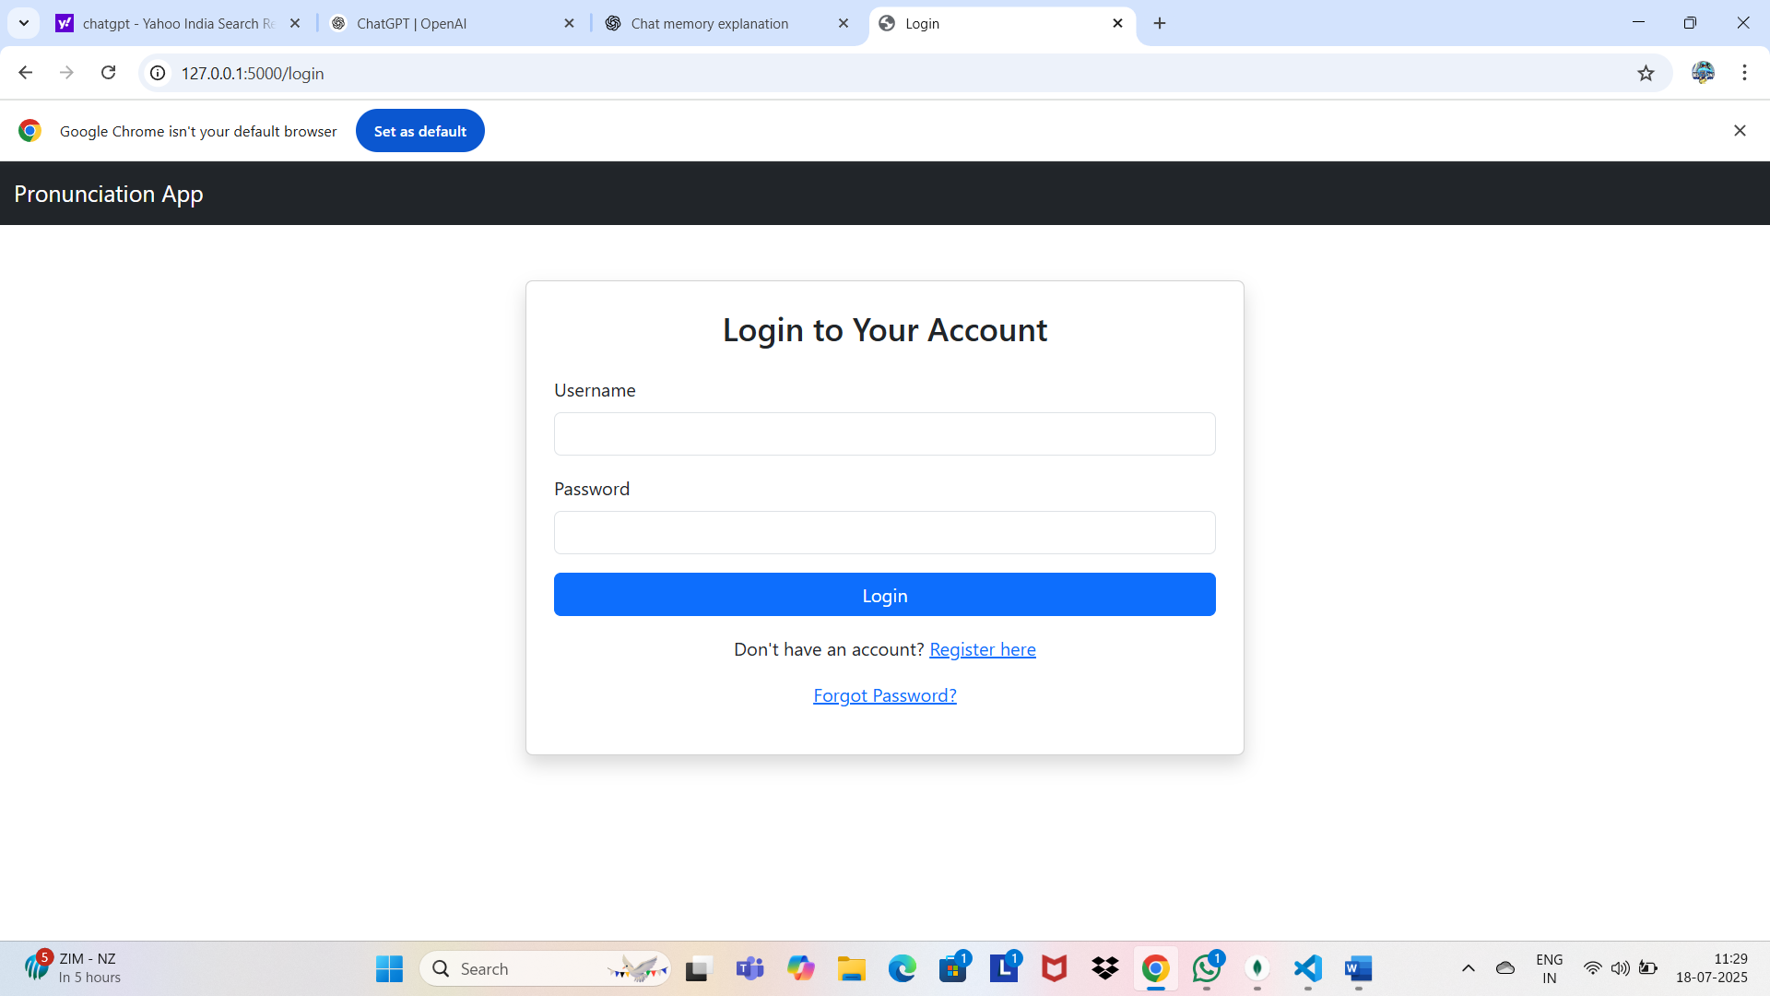
Hello

Slide 6
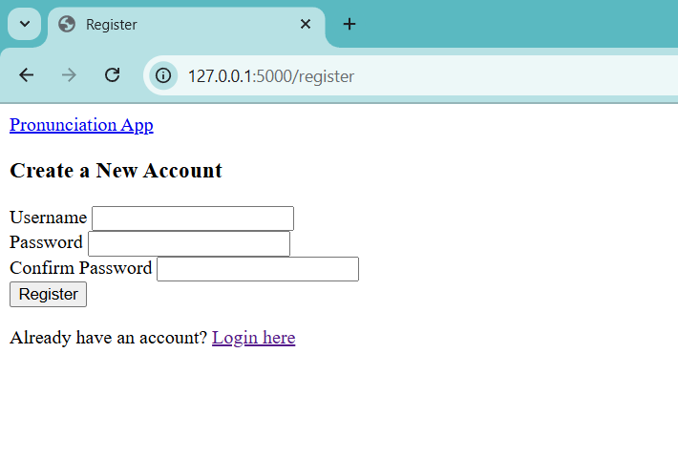
hello
Hi

Slide 7
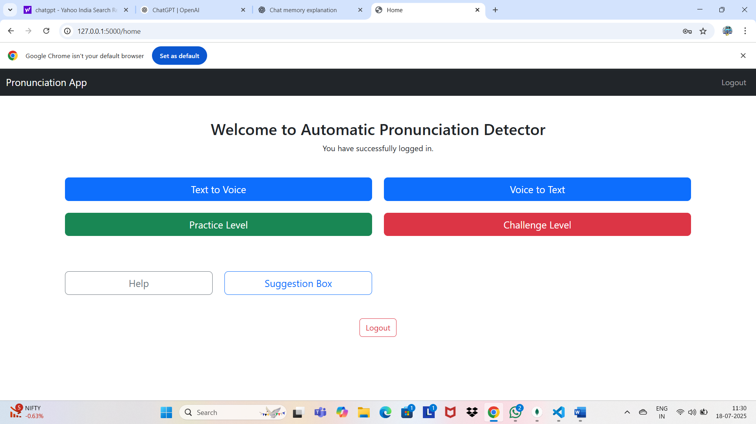
Challenge level
hrlo

Slide 8
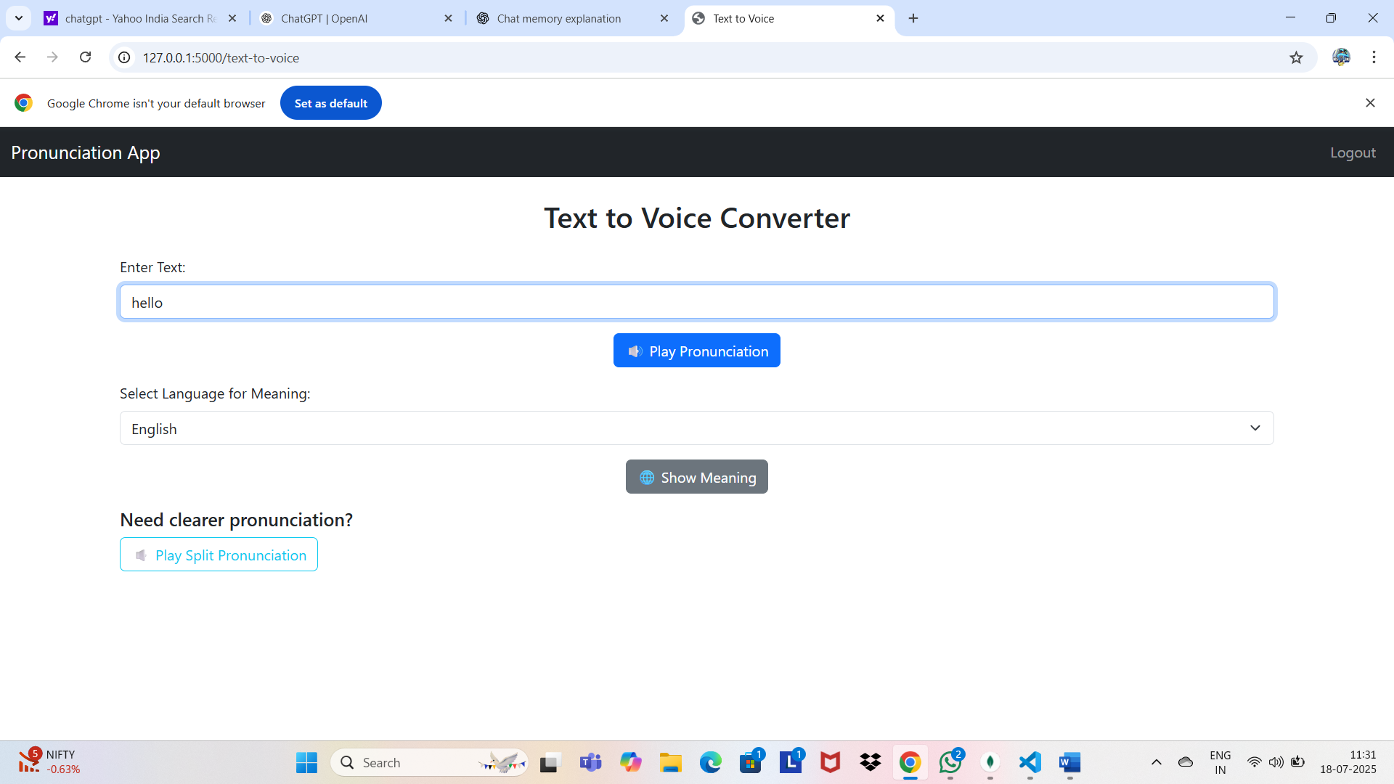
hello

Slide 9
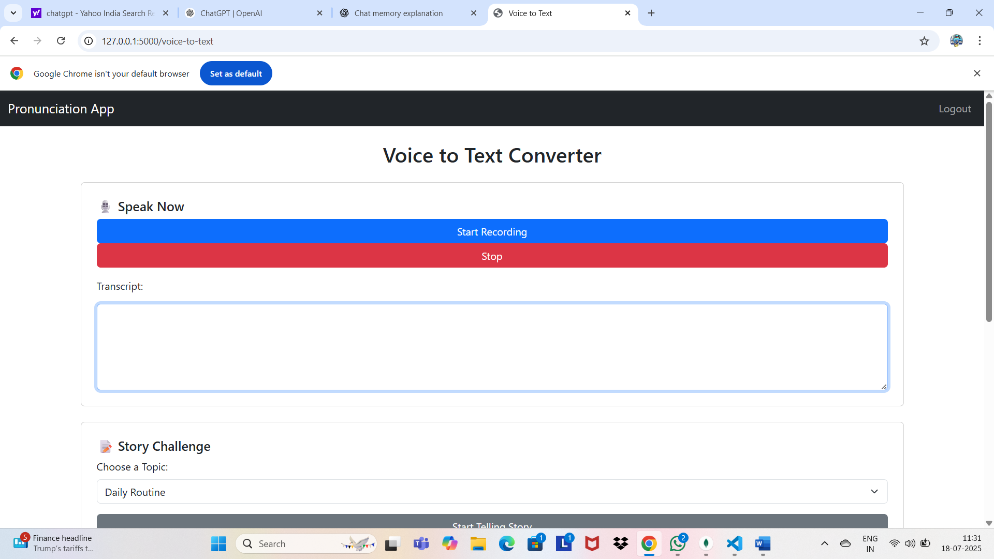
hello
hello

Slide 10
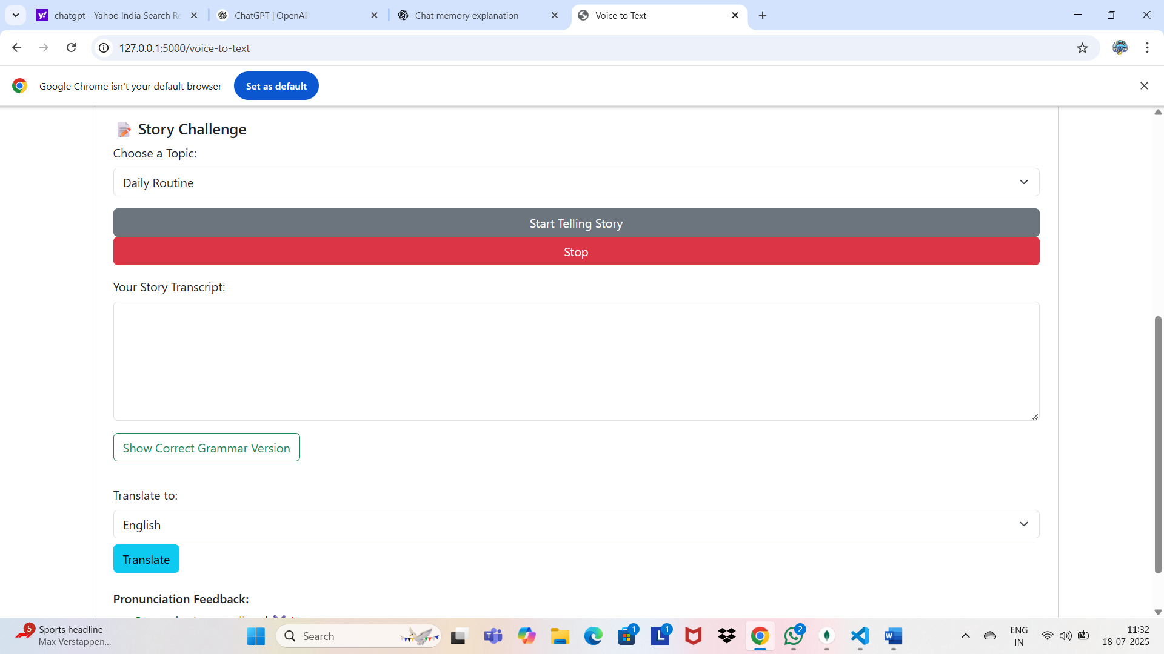
Hello

Slide 11
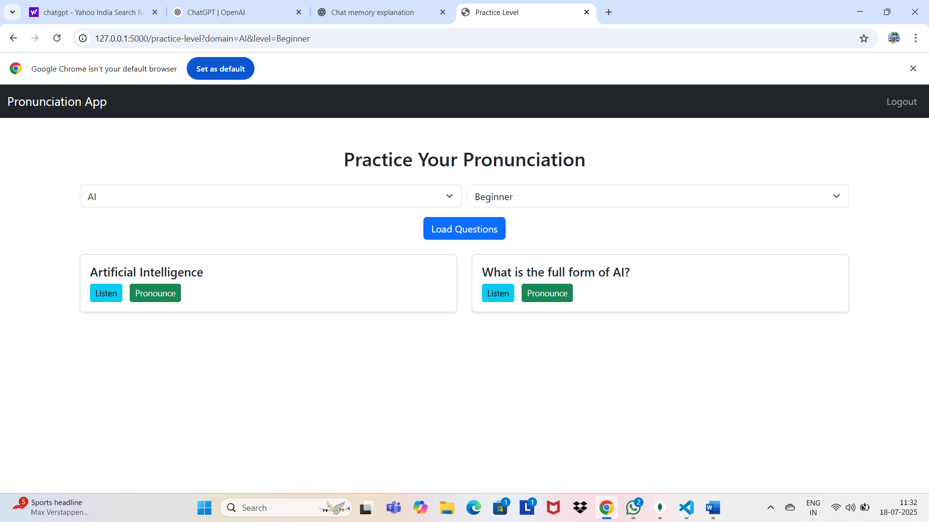
hekklo
hello

Slide 12
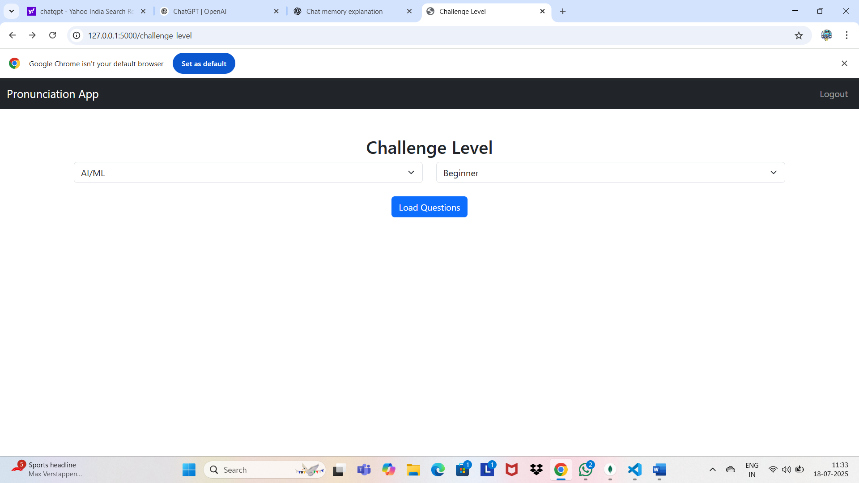
helo

Slide 13
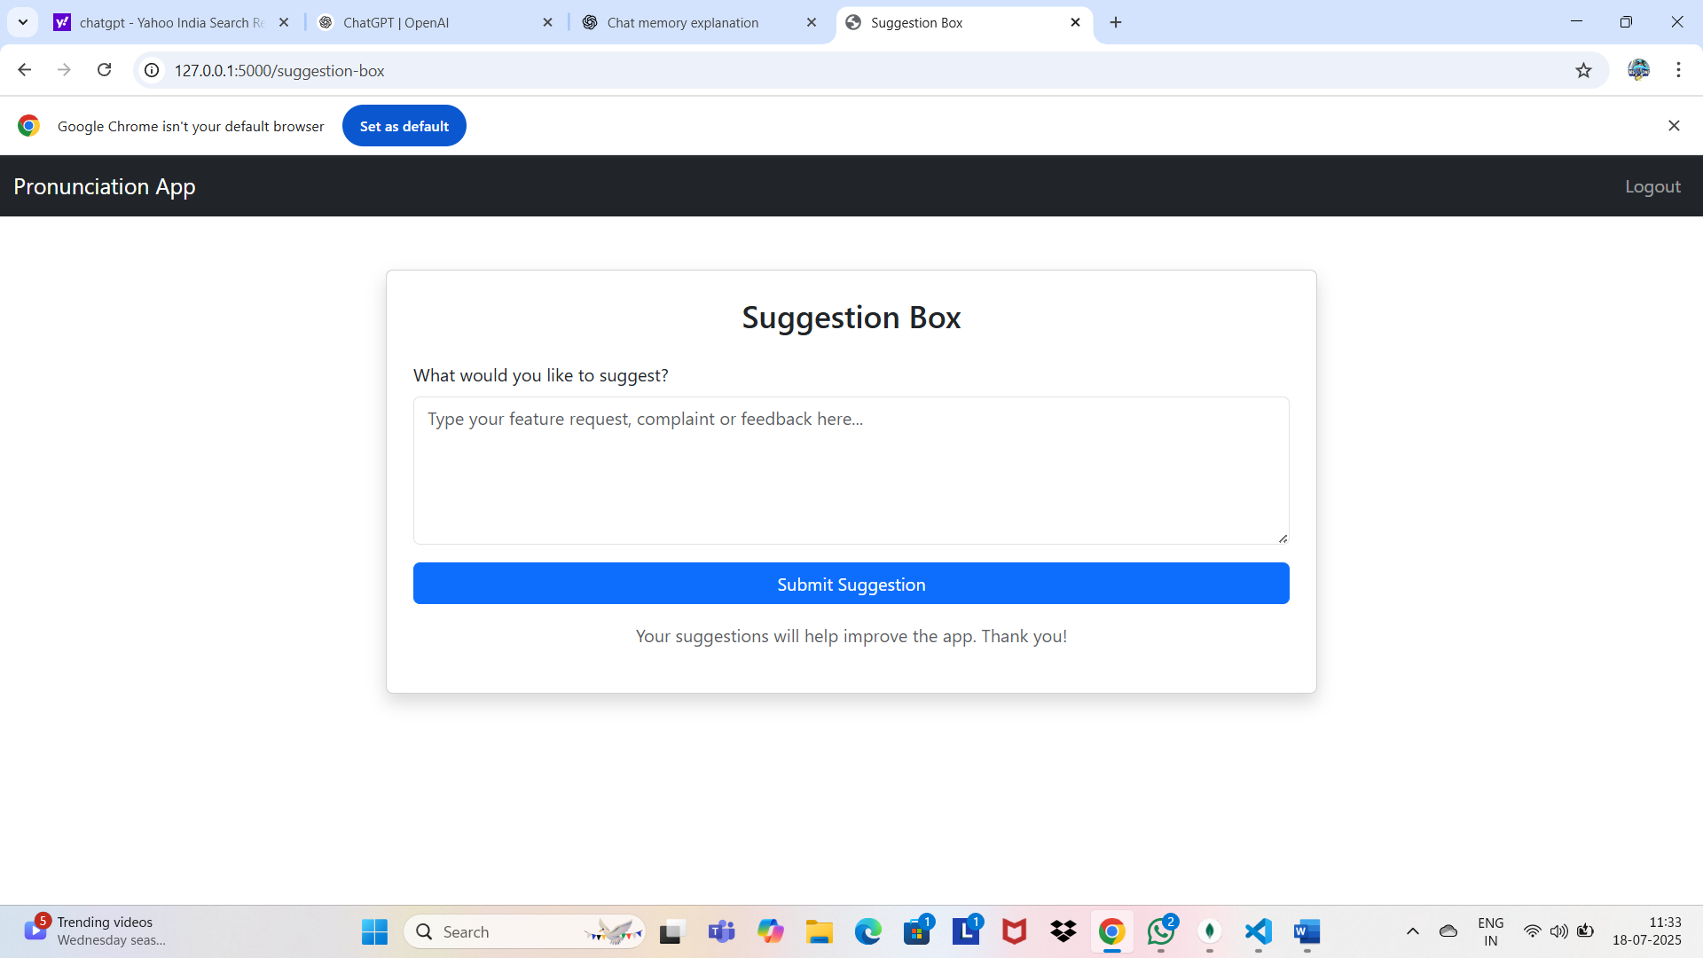
Hr.o

Slide 14
conclusion
User-friendly pronunciation learning app
Covers multiple domains and levels
Can be extended with more features (e.g., leaderboard, suggestions)
Great tool for students and beginners in English learning

Slide 15
The beautiful thing about learning is that no one can take it away from you
Thank you
Do you have any question?

